Slide 1
Clearinghouse Results Website Overview

Slide 2
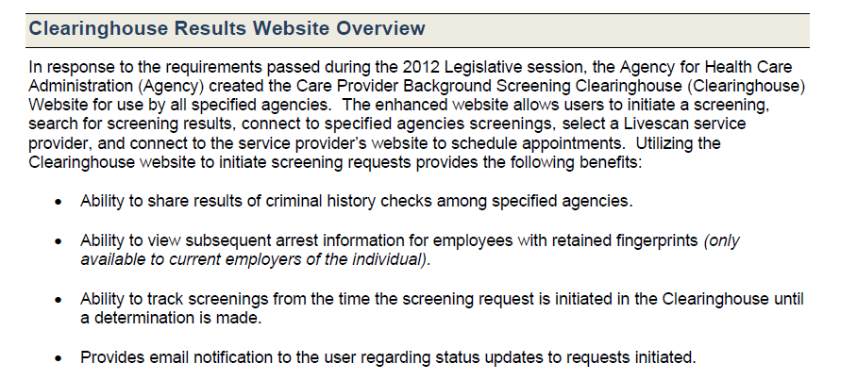

Slide 3
